Slide 1
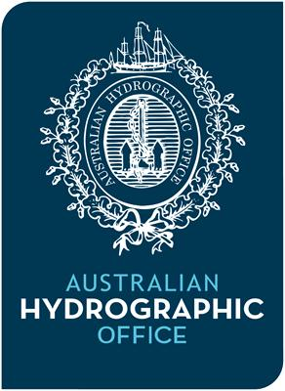
16th Meeting of the South West Pacific Hydrographic Commission National Report by Australia

Slide 2
Australian Hydrographic Office
National role (Office) sits within Australian Geospatial Intelligence Organisation
Navy survey ships and training of survey personnel remains with Navy
Legislation changes October 2017 – AHO vice AHS

Slide 3
Hydroscheme Industry Partnership Program
Defence White Paper 2016 indicates the future of Australia's hydrographic surveying capabilities will be ‘an efficient combination of commercial and military hydrographic and oceanographic surveying capabilities’
Defence project know as SEA 2400 comprises 2 capabilities:
1. focussed on delivery of ship and associated equipment (Navy responsibility),
2. a commercial hydrographic survey program delivered by industry supporting the National Survey Function (AHO responsibility) - HIPP

Slide 4
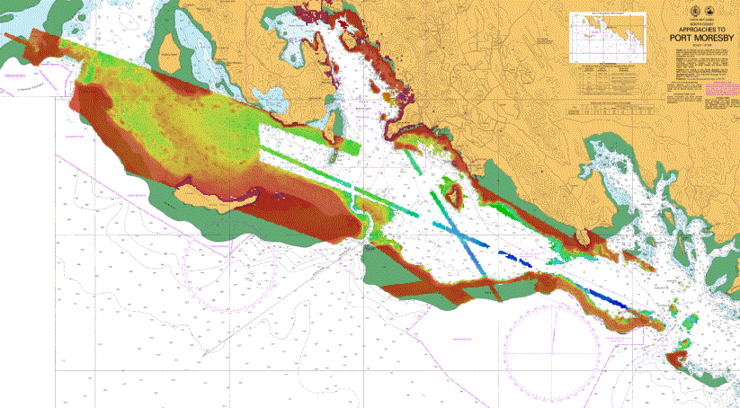
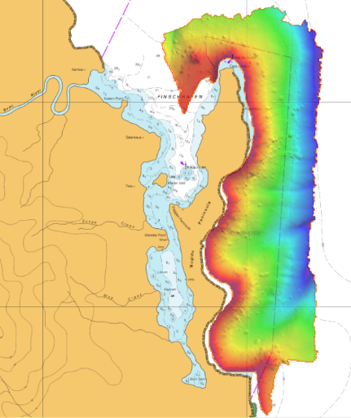
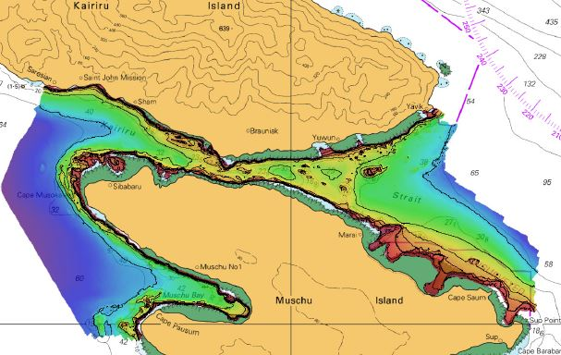
Progress on surveys, charting and publications
Surveys:
LADS – multiple Surveys in Great Barrier Reef; HI612 in PNG
Hydrographic Ships – surveying PNG for APEC 18 forum
Survey Motor Launches – HI610 Torres Strait; HI615 Timor Sea; HI611 north Western Australia
Surveys being received from PNG ADB sponsored Hydrographic Survey project
Surveys of Fischafen and Kairiru Strait in PNG
HI 606

Slide 5
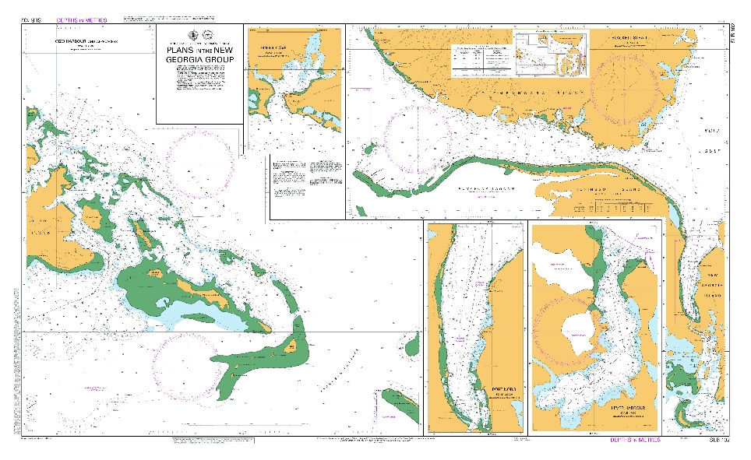
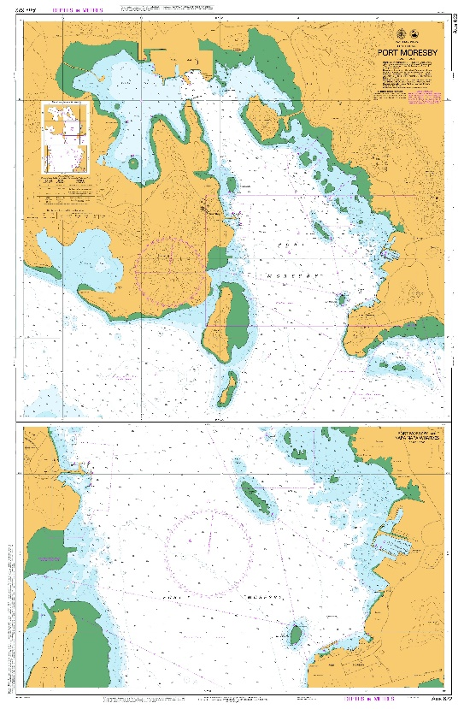
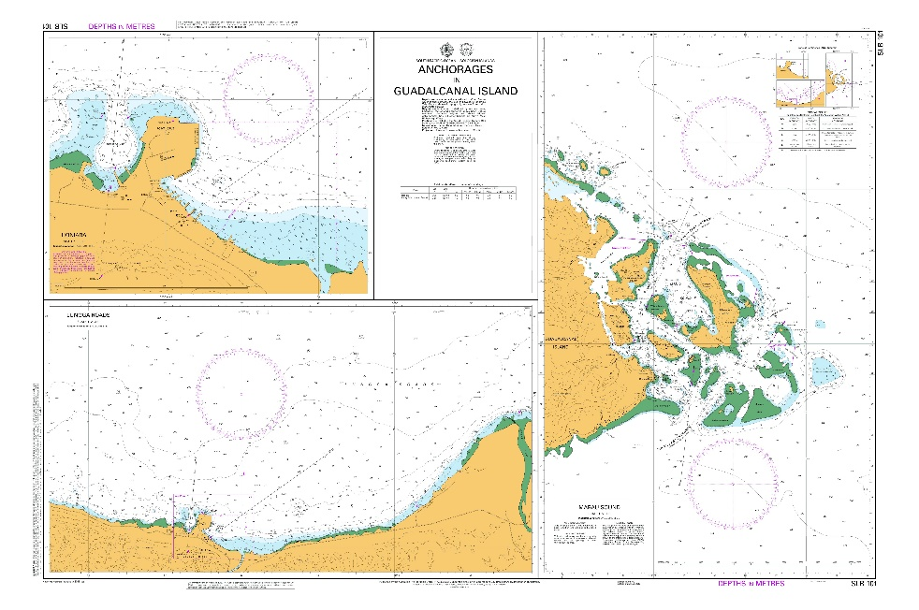
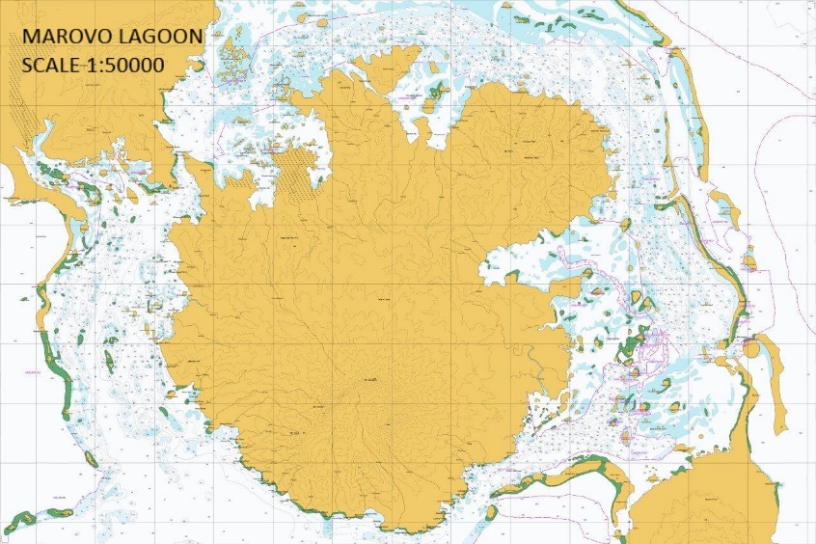
Progress on surveys, charting and publications
Charting:
48 New Editions since last meeting
SLB 102
New Marovo Lagoon SLB chart in production
SLB 101
Aus 622

Slide 6
Progress on surveys, charting and publications
Publications:
Australian National Tides Tables 2019
Solomon Islands National Tide Tables 2019
AusTides 2019

Slide 7
MSI
Current NAVAREA X MSI can be obtained from the AMSA website at:
http://www.amsa.gov.au/search-and-rescue/about-the-gmdss/msi-information/msi-email/index.asp
Operational Points of Contact for NAVAREA X National Coordinators
COUNTRY INSTITUTION TELEPHONE FACSIMILE EMAIL
New Caledonia MRCC Noumea +687 292332 +687 292303 operations@mrcc.nc
Papua New Guinea PNG MRCC +675 3212969/
+675 73517017 +675 3210873 PNGMRCC@nmsa.gov.pg
Solomon Islands MRCC Honiara +677 21609 +677 23798 mrcc@solomon.com.sb
Vanuatu Dept of Ports &
Maritime +678 33600
+678 22475 No Fax Service trobson@vanuatu.gov.vu

Slide 8
Capacity Building
2018 H2 class

Slide 9
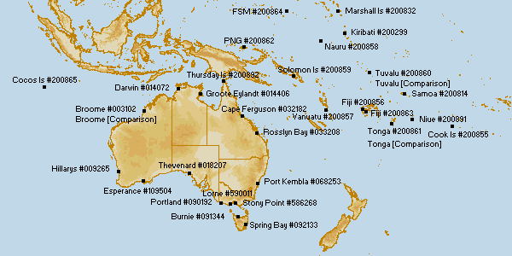
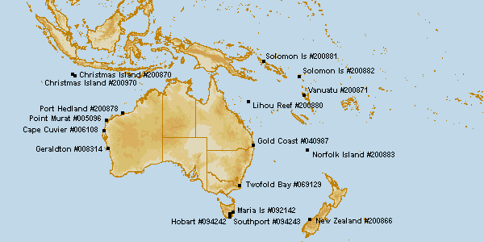
Oceanographic activities
Permanent tide gauge network operated by the Bureau of Meteorology, including the Australian Baseline Sea Level Monitoring Array (16 sites) and Pacific Sea Level Monitoring Project (14 sites)
Additional ATWS radar gauges (17 sites) that used in conjunction with the permanent tide gauge network for monitoring tsunamis in the Australian region

Slide 10
Risk Assessment
AHO is developing a Survey Risk Assessment Tool

Slide 11
Conclusion
Focus on establishment of HIPP
Improving office systems and refining processes for HIPP
Ongoing engagement with South West Pacific countries.

